Slide 1
BlueVoice on Raspberry Pi 3 and Cloud services integration (Amazon AVS and Google Speech-to-text API)

Slide 2
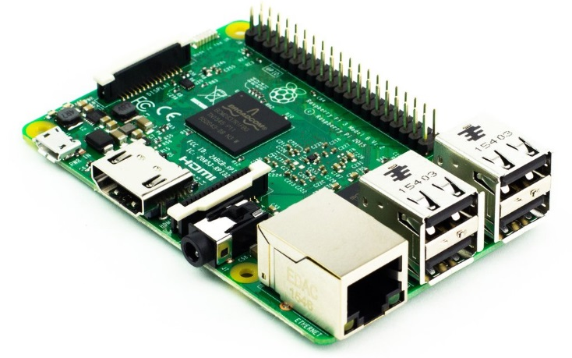


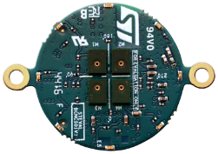
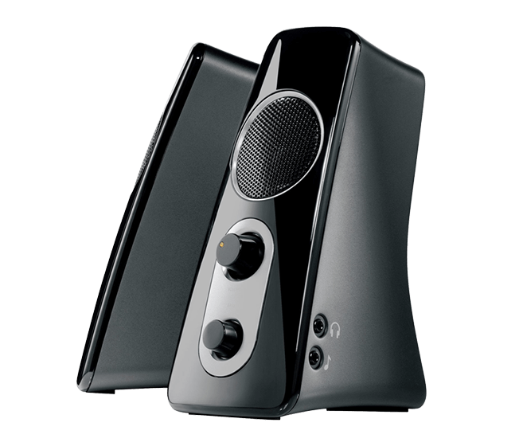
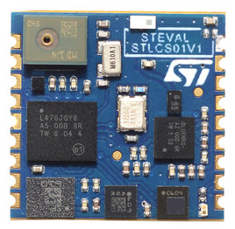
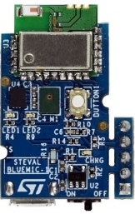
Application Overview
The ST BVLINK_rbpi3 is the application available for Linux system (eg. Raspberry) that receive the audio exported by a BLE device using the BlueVoice vendor-specific profile. The app allows to use the BLE device like a standard microphone peripheral of the system.
Capture like standard microphone
BLE 8-16K Audio transmission
Real Time playback

Slide 3
Application architecture
Python 3
Python application
BVLINK_rbpi3
Python modules
sounddevice
bluepy
Kernel Space
ALSA (aloop)
bluez
Audio I/O
BLE
HARDWARE
Raspberry Pi 3 Model B

Slide 4
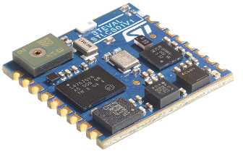



System Architecture
BlueVoice
Protocol
Raspberry pi 3
Physical output device
Headphones
Loudspeakers
ADPCM
8/16KHz
BLE
ADPCM decoder
PCM
8/16KHz
ALSA loop device
BVLINK_rbpi3
output device
Recording application
e.g. Audacity
input device
ALSA Driver

Slide 5
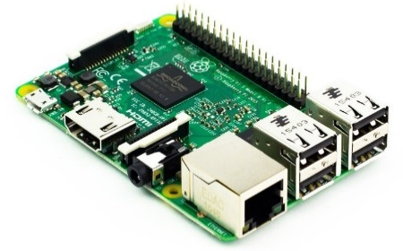




HW and SW requirements
Receiver (Linux platform)
Raspberry Pi 3 Model B
Raspbian OS (or compatible)
Python 3
BVLINK_rbpi3 application
Transmitter (one of the following)
FP-AUD-BVLINK1 Function Pack
SensorTile or BlueCoin or Nucleo+X-Nucleo
FP-SNS-ALLMEMS1 Function Pack
SensorTile or BlueCoin or Nucleo+X-Nucleo
STSW-BLUEMIC-1
STEVAL-BlueMic-1

Slide 6
Setup - Transmitter
The chosen firmware must be configured to stream BlueVoice at either 8KHz or 16KHz
FP-AUD-BVLINK1 or FP-SNS-ALLMEMS1
BV_ADPCM_Config.sampling_frequency = FR_8000; /* FR_16000; */
#define AUDIO_IN_SAMPLING_FREQUENCY FR_8000 /* FR_16000 */
STSW-BLUEMIC-1
#define AUDIO_SAMPLING_FREQUENCY (uint16_t)(SAMPLING_FREQ_8000) /* SAMPLING_FREQ_16000 */
Connection interval parameter must be set to 8:
aci_l2cap_connection_parameter_update_request(handle,
8 /* interval_min*/,
8 /* interval_max */,
0 /* slave_latency */,
400 /*timeout_multiplier*/);

Slide 7
Install the application
If you start from a clean installation of Raspbian it is recommended to upgrade the system:
sudo apt-get update
sudo apt-get upgrade
Download BVLINK_rbpi3 application from github:
git clone https://github.com/STMicroelectronics-CentralLabs/BlueVoice-for-Linux.git
Run installation scripts (requires root):
./installation.sh

Slide 8
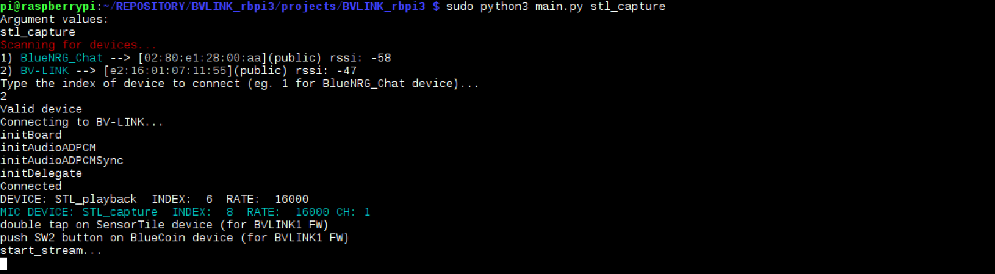
Run the application
Run main.py in BVLINK_rbpi3 directory with the chosen frequency:
sudo python3 main.py alsa_playback 16000(or 8000) (for real time playback)
or
sudo python3 main.py stl_capture 16000(or 8000) (for microphone)
Select the device
Wait connection
New mic peripheral was created
Start audio streaming

Slide 9

Integration with Amazon AVS

Slide 10
Install AVS on Raspberry
BVLINK_rbpi3 application can be used in combination with AVS (Alexa Voice Service) using “Alexa avs sample app” for Raspberry.
Detailed step by step guide is available here: https://github.com/alexa/alexa-avs-sample-app/wiki/Raspberry-Pi
Download and install the Alexa-avs-sample-app
wget https://github.com/alexa/alexa-avs-sample-app/archive/master.zip
unzip ./master.zip
cd alexa-avs-sample-app-master
./automated_install.sh
The AVS installation overwrites the “.asoundrc” file in user home directory that needs to be restored manually with one of the templates from BVLINK_rbpi3 directory:
cp ~/BVLINK_rbpi3/asoundrc_template_8000 ~/.asoundrc
OR
cp ~/BVLINK_rbpi3/asoundrc_template_16000 ~/.asoundrc

Slide 11
Run AVS app
Start web services
cd ~/Desktop/alexa-avs-sample-app/samples
cd companionService && npm start
AVS Client
cd ~/Desktop/alexa-avs-sample-app/samples
cd javaclient && mvn exec:exec
Wake-up agent
cd ~/Desktop/alexa-avs-sample-app/samples
cd wakeWordAgent/src && ./wakeWordAgent -e sensory
Now you can use your transmitter device like a standard microphone to send voice command to AVS

Slide 12

Speech-to-text using Google API

Slide 13

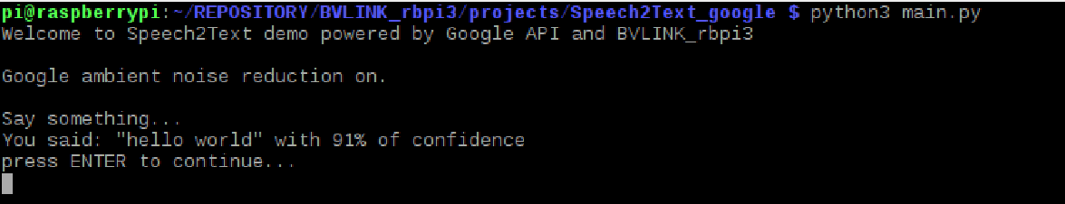
Run Speech2Text app
Set up Speech2Text
./installation.sh
Set up BVLINK_rbpi3 application as described before
Start BVLINK_rbpi3
sudo python3 BVLINK_rbpi3 / main.py stl_capture 16000
Start Speech2Text
python3 Speech2Text_google/main.py
The application waits the speech
Transcribe the speech by Google API and print it

Slide 14

Chrome browser voice command

Slide 15
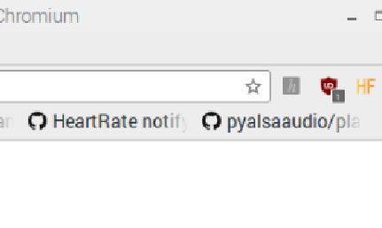
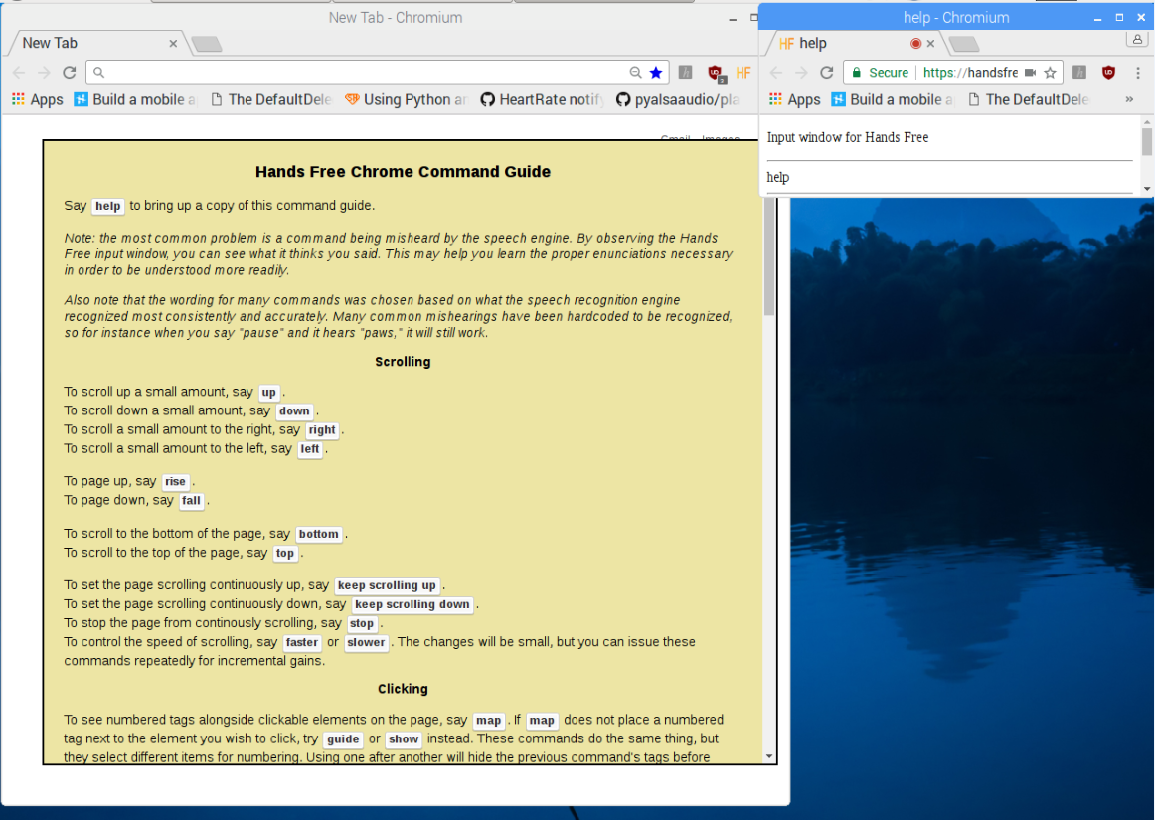
Chrome browser voice command
Start BVLINK_rbpi3 application as described before
Install Hands Free plugin for Chrome
https://chrome.google.com/webstore/detail/hands-free-for-chrome/ddgmnkioeodkdacpjblmihodjgmebnld
Click on HF button
A new window will be open
Say “help” to get a list of available commands

